Slide 1
INTEGRATING MATERIAL SELECTION WITH DESIGN OPTIMIZATION VIA NEURAL NETWORKS
How the code works for mass

Slide 2
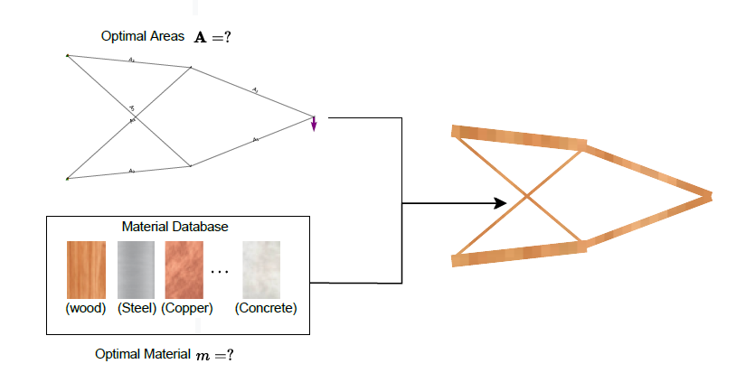
Basic optimization problem
1 -> Analyze the basic optimization problem

Slide 3
Basic optimization problem
N truss members

Slide 4
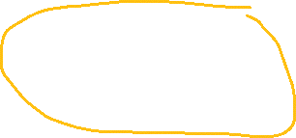
Basic optimization problem
M materials

Slide 5
Basic optimization problem

Slide 6
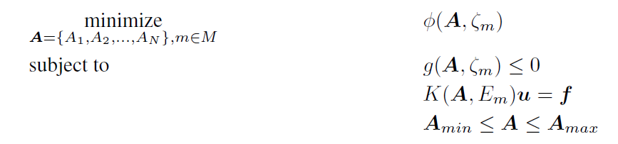
Basic optimization problem

Slide 7

Basic optimization problem

Slide 8

Basic optimization problem

Slide 9

Basic optimization problem

Slide 10
Basic optimization problem

Slide 11
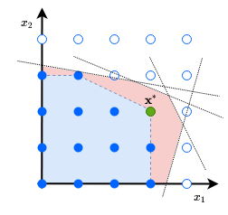
Mixed-discrete nonlinear programming problems (MDNLPs)

Slide 12
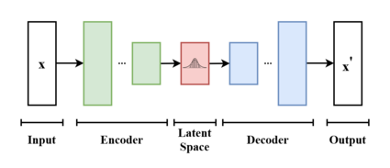
Variational Autoencoders (VAE)

Slide 13
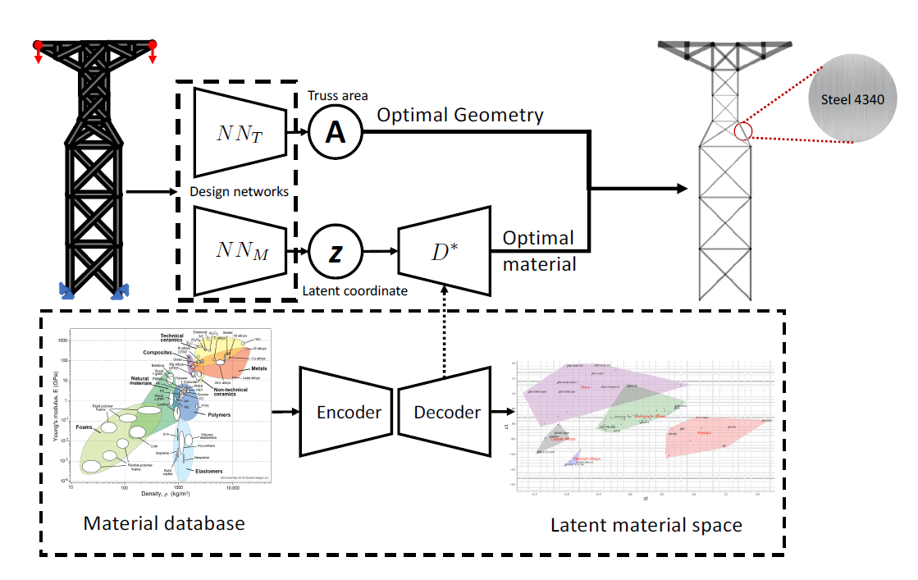
Variational Autoencoders (VAE)

Slide 14
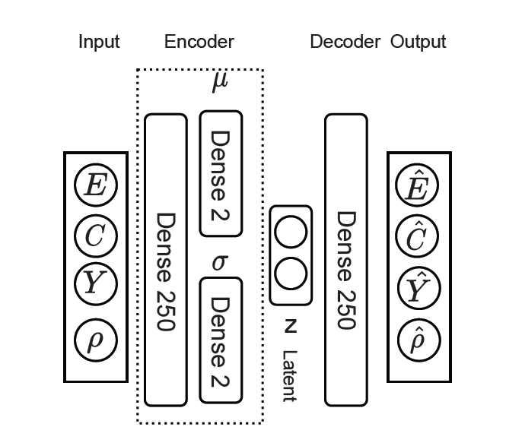
Variational Autoencoder for material database
COMPONENTS OF THE VAE
A four-dimensional input module corresponding to four properties of the material
An encoder consisting in a network of 250 neurons
A two-dimensional latent space
A decoder consisting in a network of 250 neurons
A four-dimensional output corresponding to the properties

Slide 15
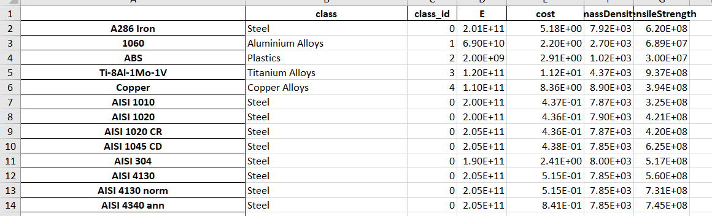
Variational Autoencoder for material database

Slide 16
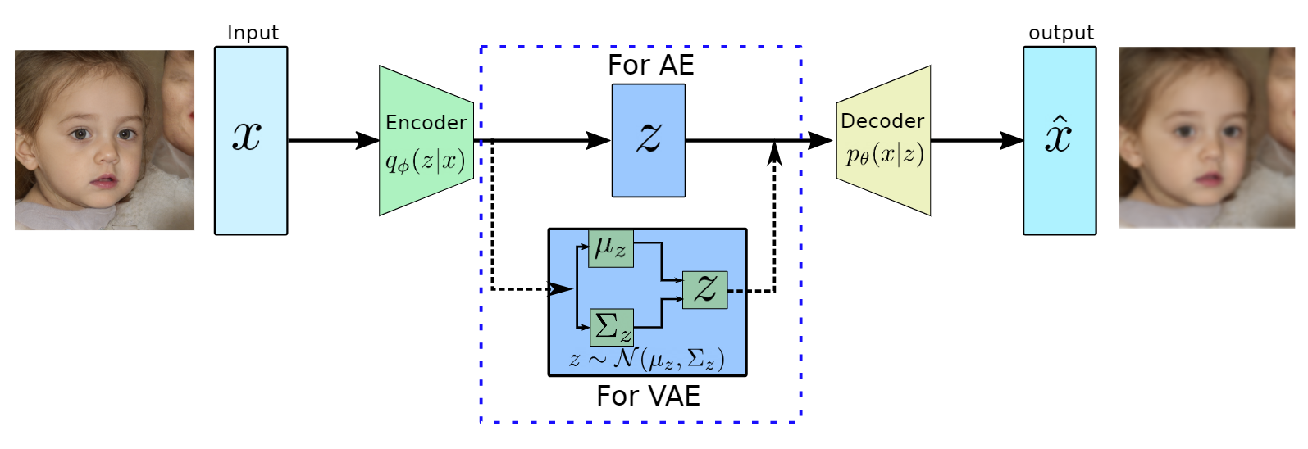
Variational Autoencoder for material database
Properties weighted equally

Slide 17

Variational Autoencoder for material database
PyTorch -> VAE
Adam optimizer ->

Slide 18
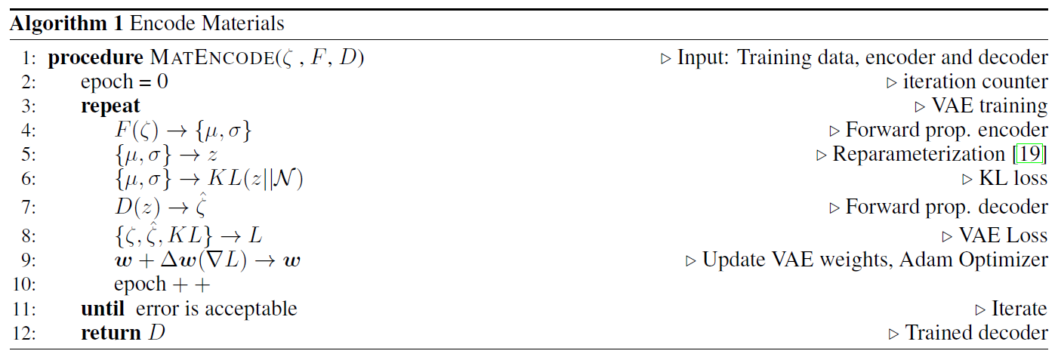
Algorithm 1: Encode Materials

Slide 19
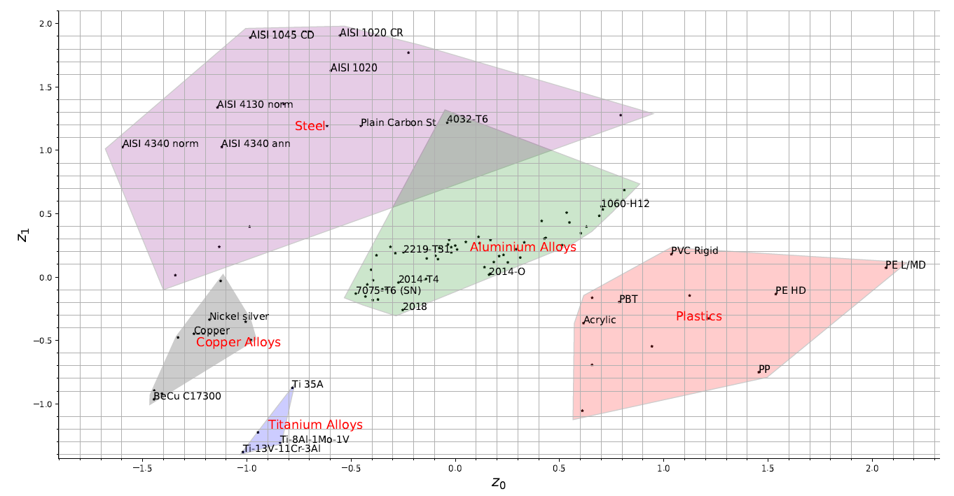
Latent Space

Slide 20
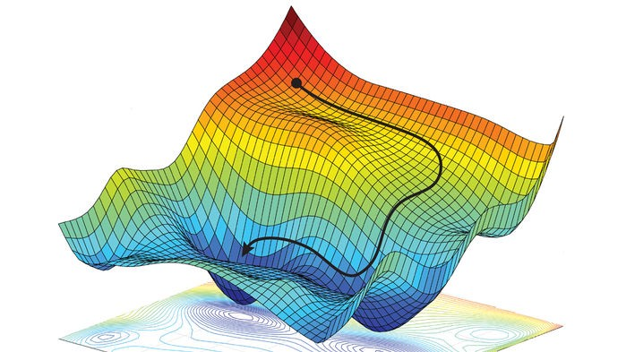
Latent Space

Slide 21
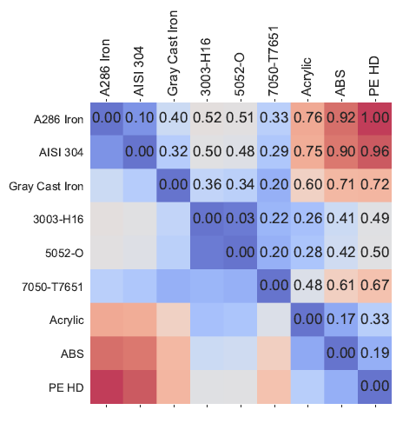
Latent Space

Slide 22
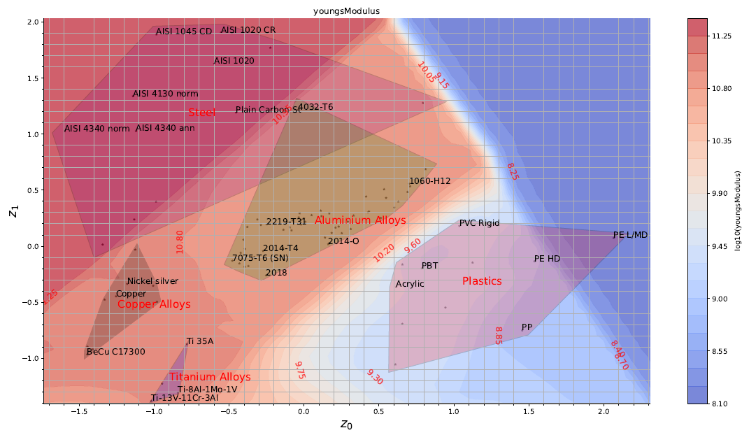
Latent Space

Slide 23
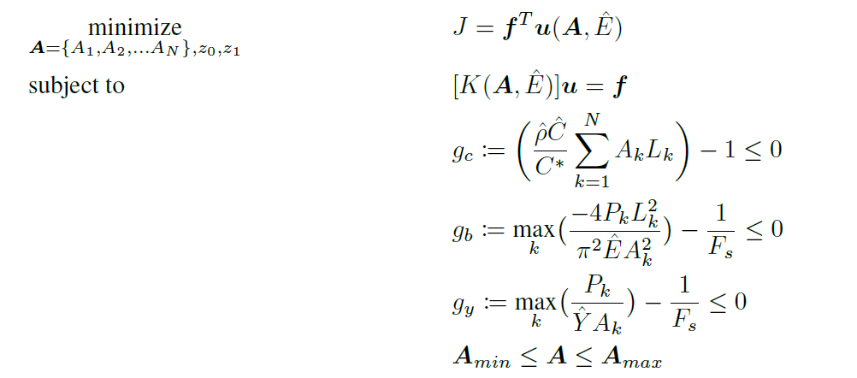

Latent Space

Slide 24


Latent Space

Slide 25


Latent Space

Slide 26
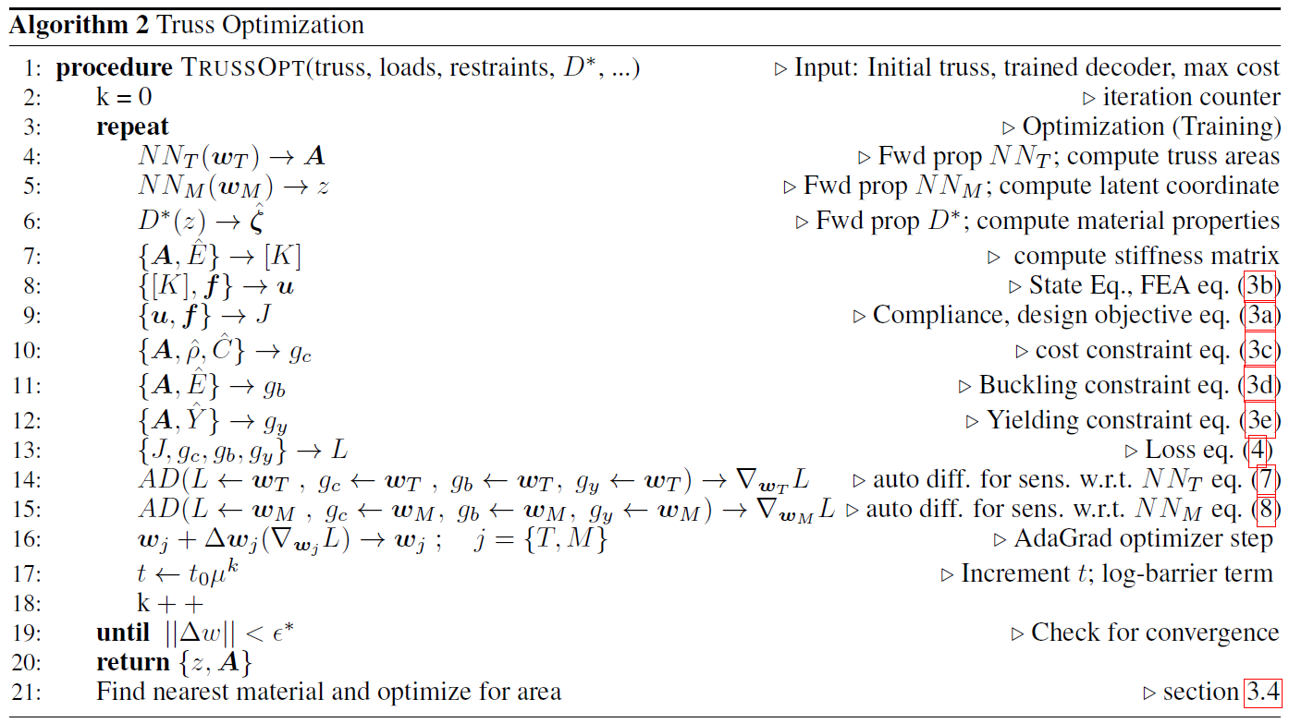
Algorithm 2: Truss Optimization

Slide 27
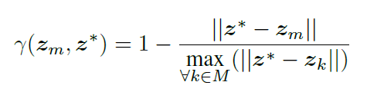
Post Processing
Get the closest “real” material
Recalculate the areas

Slide 28
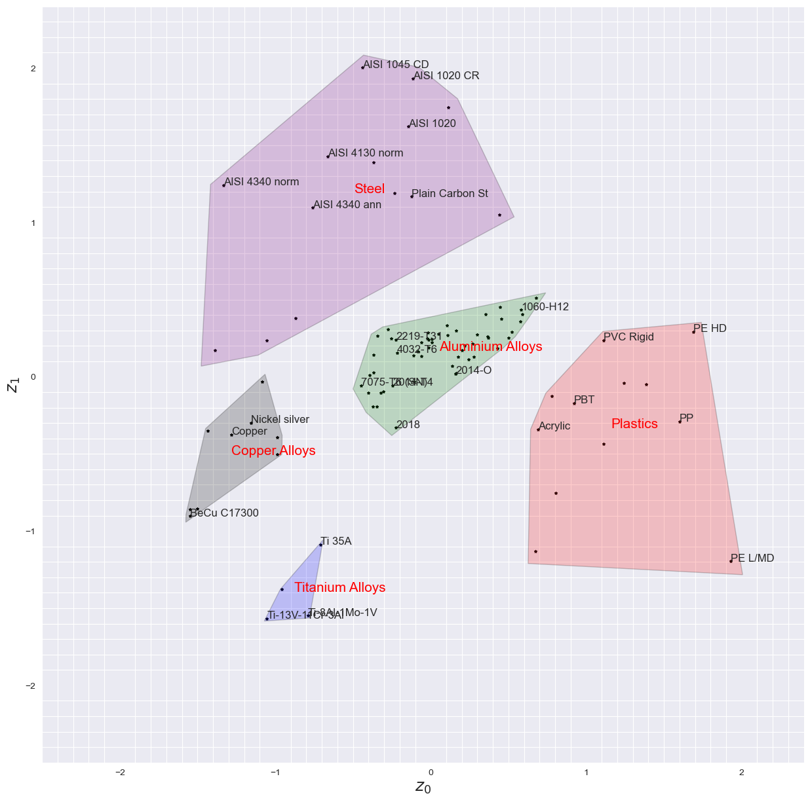
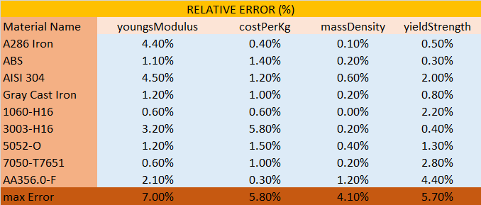
Results. VAE TRAINING FULL DATABASE

Slide 29
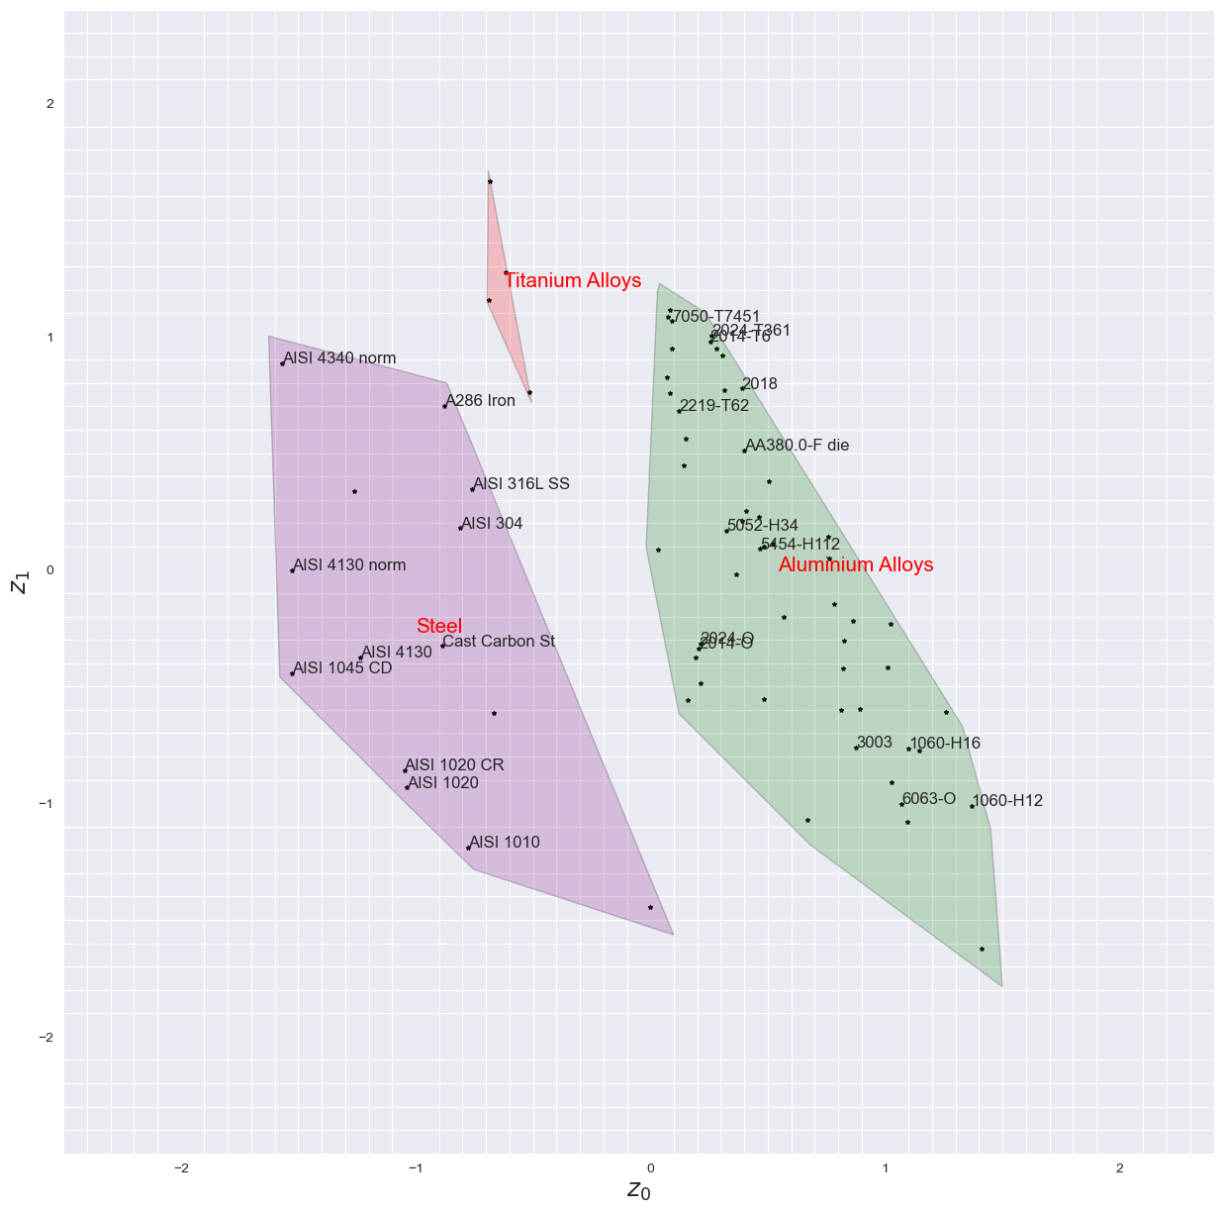
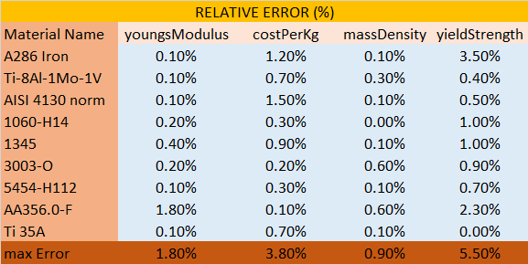
Results. VAE TRAINING REDUCED DATABASE

Slide 30
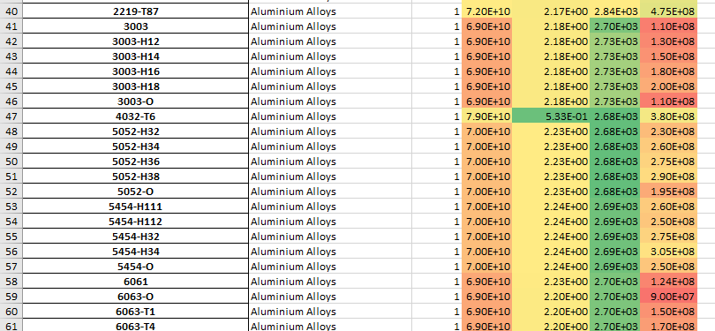
The 4032-T6 incident
Cheap as Steel, light as Aluminum,
with good strength characteristics!

Slide 31
The 4032-T6 incident
Cheap as Steel, light as Aluminum,
with good strength characteristics!

Slide 32
The 4032-T6 incident
Cheap as Steel, light as Aluminum,
with good strength characteristics!

Slide 33
Results. Example truss, buckling and yield constrain
Objective: Minimize compliance (J)
COST LIMIT (60$)
Optimal structure: J=2.61 N*m, 124kg, 54$
closest material 0 : AISI 1020 , confidence 71.76
closest material 1 : AISI 1010 , confidence 68.26
closest material 2 : AISI 1020 CR , confidence 65.36
Real structure (AISI 1020): J=2.66 N*m, 132kg, 57.6$

Slide 34
Results. Example truss, buckling and yield constrain
Objective: Minimize compliance (J)
MASS LIMIT (20Kg)
Optimal structure: J=17.3 N*m, 19.9kg, 44.4$
closest material 0 : 5052-H36 , confidence 94.99
closest material 1 : AA380.0-F die , confidence 91.03
closest material 2 : 5454-H34 , confidence 88.65
Real structure (5052-H36): J=17.1 N*m, 19.9kg, 44.4$

Slide 35
Results. Example truss, buckling and yield constrain
Objective: Minimize compliance (J)
MASS LIMIT (40Kg)
Optimal structure: J=8.65 N*m, 38.7kg, 94.3$
closest material 0 : 5052-O , confidence 89.83
closest material 1 : 5454-H112 , confidence 89.75
closest material 2 : 5454-H111 , confidence 89.54
Real structure (5052-O): J=8.83 N*m, 38.6kg, 86.1$

Slide 36
Results. Example truss, buckling and yield constrain
Objective: Minimize compliance (J)
MASS LIMIT (80Kg)
Optimal structure: J=3.25 N*m, 79.9kg, 645$
closest material 0 : Ti-8Al-1Mo-1V , confidence 62.89
closest material 1 : Ti-8Mn Ann , confidence 60.28
closest material 2 : Ti-13V-11Cr-3Al , confidence 58.51
Real structure (Ti-8Al-1Mo-1V ): J=4.05 N*m, 80kg, 899$

Slide 37
Results. Example truss, buckling and yield constrain
Objective: Minimize compliance (J)
MASS LIMIT (80Kg)
Real structure (Ti-8Al-1Mo-1V ): J=4.05 N*m, 80kg, 899$
Real structure (5052-O): J=4.25 N*m, 80kg, 179$
Real structure (5052-H36): J=4.25 N*m, 80kg, 178$
At 80kg, limited first by yield strength and then by mass…

Slide 38
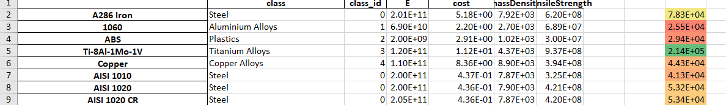
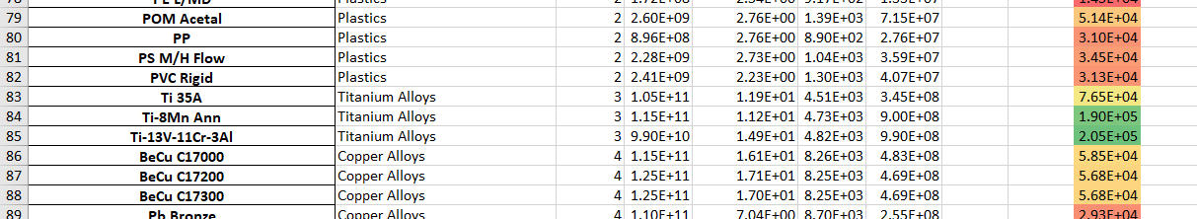
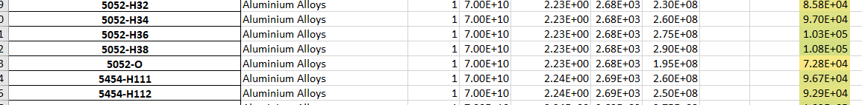
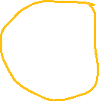

Slide 39
Results. Example truss, buckling and yield constrain
Objective: Minimize mass (M)
COMPLIANCE LIMIT (12 N*m)
Optimal structure: J=12 N*m, 30.7kg, 156$
closest material 0 : A286 Iron , confidence 74.58
closest material 1 : AISI 304 , confidence 72.55
closest material 2 : AISI 316L SS , confidence 72.16
Real structure (A286 Iron): J=12 N*m, 29.2kg, 151$
Real structure (AISI 304): J=12 N*m, 31.2kg, 75$

Slide 40
Results. Example truss, buckling and yield constrain
Objective: Minimize mass (M)
Optimal structure: J=60.3 N*m, 13kg, 60.3$
closest material 0 : AISI 4340 norm , confidence 75.68
closest material 1 : A286 Iron , confidence 71.91
closest material 2 : AISI 4340 ann , confidence 68.87
Real structure (AISI 4340 norm): J=57.9 N*m, 12.5kg, 10.5$

Slide 41
Results. Example truss, buckling and yield constrain
Objective: Minimize cost (C)
Optimal structure: J=48.7 N*m, 12kg, 5.25$
closest material 0 : AISI 1020 , confidence 71.76
closest material 1 : AISI 1010 , confidence 68.26
closest material 2 : AISI 1020 CR , confidence 65.36
Real structure (AISI 1020): J=28.9 N*m, 15.3kg, 6.68$

Slide 42
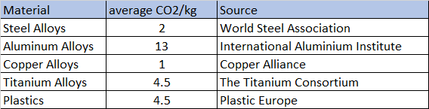
Results. CO2 Optimization

Slide 43
Results. CO2 Optimization, buckling and yield constrain
COMPLIANCE LIMIT (12 Nm)
Objective: Minimize CO2
Optimal structure: J=12 N*m, 27.9kg, 17$, 56.2kg CO2
closest material 0 : AISI 4130 norm , confidence 89.38
closest material 1 : AISI 4130 , confidence 89.13
closest material 2 : AISI 1045 CD , confidence 86.68
Real structure (AISI 4130 norm ): J=12 N*m, 28.6kg, 14.7$, 57.3kg CO2

Slide 44
Results. CO2 Optimization, buckling and yield constrain
MASS LIMIT (40 kg)
Objective: Minimize CO2
Optimal structure: J=128 N*m, 9.6kg, 157$, 41.9kg CO2
closest material 0 : Ti-13V-11Cr-3Al , confidence 75.86
closest material 1 : Ti-8Al-1Mo-1V , confidence 68.52
closest material 2 : Ti-8Mn Ann , confidence 66.86
Limited by yield and compression!
Real structure (Ti-13V-11Cr-3Al): J=103 N*m, 10.7kg, 160$, 48.4kg CO2

Slide 45
Results. CO2 Optimization, buckling and yield constrain
COST LIMIT (200$)
Objective: Minimize CO2
Optimal structure: J=129 N*m, 9.44kg, 154$, 41.2kg CO2
closest material 0 : Ti-13V-11Cr-3Al , confidence 75.86
closest material 1 : Ti-8Al-1Mo-1V , confidence 68.52
closest material 2 : Ti-8Mn Ann , confidence 66.86
Real structure (Ti-13V-11Cr-3Al): J=103 N*m, 10.7kg, 160$, 48.4kg CO2

Slide 46
Results. CO2 Optimization, buckling and yield constrain
COST LIMIT (30$)
Objective: Minimize CO2
Optimal structure: J=79.6 N*m, 6.46kg, 13.9$, 84kg CO2
closest material 0 : 4032-T6 , confidence 69.12
closest material 1 : 7050-T73510 , confidence 63.01
closest material 2 : 2014-T6 , confidence 62.34
Limited by yield and compression + cost
Real structure (4032-T6): J=61.7 N*m, 7.45kg, 16.4$, 96.8kg CO2

Slide 47


Results. CO2 Optimization, buckling and yield constrain
COST (50$), MASS (35Kg), COMPLIANCE (24 N*m)
Objective: Minimize CO2
TERRIBLE APPROXIMATION OF CO2 PROPERTIES
Optimal structure: J=23.8 N*m, 10.3kg, 4.47$, 133kg CO2
closest material 0 : AISI 1020 CR , confidence 72.13
closest material 1 : Cast Carbon St , confidence 69.65
closest material 2 : AISI 1010 , confidence 69.06
Real structure (AISI 1020 CR): J=24 N*m, 16.4kg, 7.16$, 32.8kg CO2

Slide 48


Results. CO2 Optimization, buckling and yield constrain
COST LIMIT (200$)
Objective: Minimize CO2
Optimal structure: J=129 N*m, 9.44kg, 154$, 41.2kg CO2
closest material 0 : Ti-13V-11Cr-3Al , confidence 75.86
closest material 1 : Ti-8Al-1Mo-1V , confidence 68.52
closest material 2 : Ti-8Mn Ann , confidence 66.86
Real structure (Ti-13V-11Cr-3Al): J=103 N*m, 10.7kg, 160$, 48.4kg CO2

Slide 49
¿Why chose Titanium instead of Steel?
“Bad Latent Space”
Bad optimizer (log loss function)
One latent space for each subset of material sharing similar properties, then bruteforce search among the best material of each category
Proposed solution

Slide 50
Proposed Work
Write a paper
Clean the code / Rewrite
Adapt my method of bruteforce with subsets
Increase the database with more materials, properties and better CO2 estimation
Analyze 3D structures
Deepen the latent space with 3 dimensions (Graphic representation of point clouds, compare results with 2D latent space, required time…)

